Slide 1
ALDRIV
The Business Banking Platform Built for SMEs & IT Professionals
www.aldriv.com

Slide 2

SMEs Waste Time & Money On Banking
Traditional Banks Are Slow
Opening accounts takes weeks. Getting cards for team members is complicated. International payments are expensive and unclear.
Manual Processes Kill Productivity
Finance teams spend hours on expenses reports, reconciliation,and accounting. No real-time visibility into company spending.
Hidden Costs Add Up
Monthly fees, card fees, transactions fees, FX markups. SMEs pay premium prices for basic business banking.

Slide 3


The Solution
One platform for All Business Banking Needs:
Open business accounts in minutes, not weeks. Get IBANs and cards immediately.
Team management: Issue unlimited virtual and physical cards with custom spending limits and controls
Automated Accounting: Real-time expense tracking. Direct integration with accounting software. One-click reconciliation.
No hidden fees. Competitive FX rates. Pay only for what you use.

Slide 4
Target Market
Focus: SMEs & IT Professionals
IT Freelancers - Developers, designers, consultants needing needing professional business accounts
Small Teams - Startups and agencies with 2-20 employees
Growing SMEs - Established businesses with 20-150 employees

Slide 5



MARKET OPPORTUNITY
25M+ SMEs in Europe
€190B SME Banking Market
65% Unhappy with Current Bank

Slide 6
VISION & MISSION
OUR VISION
To be the most preferred online payment processing service provider for website owners of any size.
OUR MISSION
To provide a simple and fully automated online payment gateway for website business owners across the globe.

Slide 7
Our Motto
Make the latest payment technologies affordable for everyone

Slide 8


OUR BUSINESS CORE MODEL
FintechsDev proprietary Omni-channel payment processing platform, 120+ global and local payment methods (including VISA, MasterCard, Google Pay, Apple Pay, Samsung Pay, SEPA, ACH, PayPal, SWIFT, Alipay+, Mybank, iDeal, etc.)
Core services
Basic: One business IBAN, one physical card, Unlimited virtual cards, basic account integration, 50 free transactions/month
Team: Everything in Basic, Up to 5 Team Members, 5 Physical Cards, Advanced Spending Controls, 200 Free Transactions/month, Priority Support
Business: Everything in Team, Unlimited Team Members, Unlimited Physical Cards, API Access, Unlimited Transactions, Dedicated Account Manager

Slide 9

WHY FINTECHSDEV IS BETTER
Simple
Simpler UX with native accounting integration, multicurrency support, and 24/7 customer support.
Cost-effective
Better pricing than traditional banks

Slide 10
LOCAL FIRST, GLOBAL NEXT
Target (Local Market): 800 business clients, 25k+ users
Strategy
Partner with local business associations
Target tech hubs and business centers
Localized content marketing
Referral program
Markets: EMEA region, followed by other key markets
Strategy
Leverage local market success stories
Localized marketing campaigns
Strategic B2B partnerships
SEO and digital advertising

Slide 11

COMPETITION
Stripe.com
Limitations: works with low risk and tangible goods only. No crypto support. No neobank IBAN accounts and cards.
Moonpay.com
Limitations: too expensive. High min. threshold. No crypto exchange. No neobank IBAN accounts and cards.
Revolut.com
Limitations: no payment gateway.

Slide 12
ORGANIZATIONS AND
LOGISTICS PLANS
SHORT TERM PLANS
LONG TERM PLANS
ESTABLISH AND OPERATING OFFICE
HIRE 20-25 LOCAL EMPLOYEES DURING THE FIRST YEAR: BACKEND AND FRONTEND DEVELOPERS, QUALITY ASSURANCE TEAM, BUSINESS DEVELOPMENT AND SALES TEAM, SYSADMIN TEAM
FOCUS ON SPANISH MARKET AND GAIN CONSIDERABLE RECOGNITION NEGOTIATE AND CONTRACT WITH BIG CLIENTS THROUGH EXISTING PARTNER PERSONAL RELATIONS (EL CORTE INGLES, CARREFOUR, MEDIAMARKT AND OTHERS).
EXPAND THE TEAM TO AT LEAST 350-400 EMPLOYEES TO ENABLE STABLE GROWTH AND OPERATIONS DEVELOPMENT.
BECOME A LEADER ON SPANISH MARKET IN ONLINE AND OFFLINE PAYMENTS
LAUNCH MARKETING EU-WIDE
NEGOTIATE LEADS THROUGH ESTABLISHED DOMINANT SALES FUNNELS
CONTINUE WITH EXPANSION TO FOREIGN MARKETS (USA, EMEA, APAC)
FOCUS ON CONTINUOUS IMPROVEMENTS AND IMPLEMENTATIONS OF NEW TECHNOLOGICAL SOLUTIONS AND SERVICES.

Slide 13
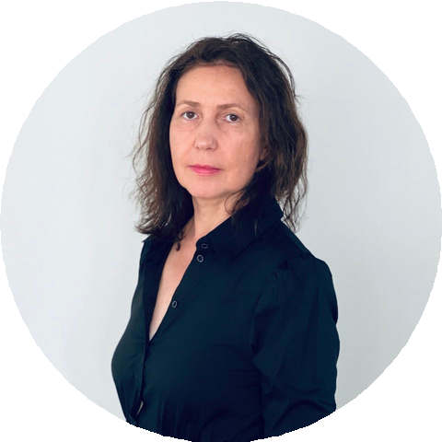
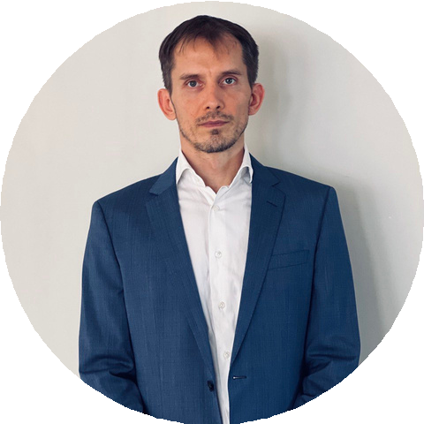
MEET THE FOUNDERS
INNA PRAVOSUD CEO
Has over 20 years of successful businesses startup and management, controlling and supervising accurate and unique strategies for success. Team builder. Creates, generates ideas. Connects key people whose participation is needed for business success.
PAVEL PRAVOSUD
CHIEF PRODUCT MANAGER
Exec. MBA, MFM, MPM. Lead Portfolio Manager and Business Analyst.
17+ years' experience with commercial (NTT Data, IPBS, Alight, MSP) and gov. projects (EMA – European Medicinal Agency, EUIPO – EU Intellectual Property Organization).
Experience in EU banking and investment management.

Slide 14

We're seeking € 450,000
The investment will be allocated: Startup
Development Licensing
Launching of the new payment gateway Marketing campaign
SEED FUNDING
Time to rollout: 5-7 months*.
* - Time to rollout refers to the FintechsDev Payment Gateway. Other projects indicated in this deck shall be prioritized and planned individually.

Slide 15

Let’s Build the Future
Join us in revolutionizing business banking for SMEs
EMAIL ADDRESS
pavel.pravosud@fintechsdev.com
PHONE NUMBER
+34-650-374-849
WEBSITE
www.aldriv.com

Slide 16
THANK YOU!
FINTECHSDEV - BRINGING THE LATEST FINANCIAL TECHNOLOGIES TO YOU

